Slide 1
Real Estate Trends after an Election (2012 & 2016)
By Michael Bone, Julian Rojas, and Christian Anderson

Slide 2
Motivation & Summary Slide (part 1)
Define the core message or hypothesis of your project.
We anticipate that there are potentially similar trends in the real estate market after each presidential election and will conduct analysis in order to examine whether the 11-month period after the 2012 and 2016 elections reveal any leverageable trends.

Slide 3
Motivation & Summary Slide (part 1I)
Describe the questions you asked
Have the results of the election affected the housing market in any noticeable manner in the 11-month period after?
Are there areas and regions that are more heavily affected than others?
With this data do we see any trends that could used to predict the timeline of a future crisis?
Why did you ask those questions?
We asked these questions because we felt that the effect of an election on real estate market values was something that could be observed by focusing on specific metrics, mapping out data over a period of time, and then identifying any trends.
We believe that if we saw any similar trends happen in two different presidential elections, that that knowledge could reveal something about what might happen to real estate values after the next future election.

Slide 4
Motivation & Summary Slide (part I1I)
Describe whether you were able to answer these questions to your satisfaction, and briefly summarize your findings
We were able to some degree, gain satisfaction in the search for the answers. We found a few metrics that we felt were reliably measuring the information we needed to gain an understanding of the big picture and then focused on identifying trends over time in hopes of answering our questions. The limitations in this situation were the amounts and type of data that was accessible to us, as well as the lack of granularity our data provided.

Slide 5
Questions & Data
Elaborate on the questions you asked, describing what kinds of data you needed to answer them, and where you found it
Have the results of the election affected the housing market in any noticeable manner in the 11-month period after?
For this questions we pulled data sets from Data World that had the data by state for each month for the 11 months after the start of the election month. Each data set pertained to a different metric (state median listing price, state median price reduction percentage, state ZHVI summary, and state inventory measure).
We also merged other data sets that contained information like each states political party majority, and each states latitude and longitude in order to aid our analysis.
Are there areas and regions that are more heavily affected than others?
For this question, we just needed to be able to map our trends using tools like an API pull and Google Heat Maps which allowed us to see more clearly if there were any regional tendencies.
With this data do we see any trends that could used to predict the timeline of a future crisis?
For this question, the ability to create graphs that visually display trends was important because it was the best way to see if there were any similarities between the 2012 and 2016 election, that could potentially be leveraged in the future.

Slide 6
Data Cleanup & Exploration (PART i)
Describe the exploration and cleanup process
We filtered through the 10 years worth of data by creating a data set that only contained the periods that we wanted.
We set the state name as the index for each of the data sets because it was a unique identifier that allowed us to manipulate the data better.
Converting the data from a data set to a list and vice versa was necessary in order to manipulate the data as needed.
We merged other data sets that contained information like each states political party majority, and each states latitude and longitude in order to aid our analysis.
We created , cleaned up, and renamed columns and calculated the information we needed that wasn’t provided by the original data set.
We removed Puerto Rico from the original data set all together because there was no voting information available at all for them.

Slide 7
Data Cleanup & Exploration (PART iI)
Discuss insights you had while exploring the data that you didn't anticipate
An insight we had was the importance of cleaning and formatting the data. Problems that were encountered while coding a lot of times had to do with an issue in the source data (i.e an NA value) that wasn’t accounted for initially.
Discuss any problems that arose after exploring the data, and how you resolved them
When we initially started our project, we had to change directions several times due to issues we encountered when we tried to dig deeper into the data. We resolved them by changing the topic and by narrowing the focus of the data we were pulling.
The limitations that arose once we analyzed the data accessible to us with minimal issues, were the quantity and the type of data that was accessible to us, as well as the lack of granularity our data provided. We resolved this by focusing in on our questions and the high-level trends which could be observed.

Slide 8
Data Cleanup & Exploration (PART iII)
Present and discuss interesting figures developed during exploration, ideally with the help of Jupyter Notebook
We did not anticipate both elections having the such similar results in terms of the housing market, especially given the volatile nature of both elections (see jupyter notebook for graph).
We did not expect to see such a difference in inventory measures given that the median listing price largely followed the same trend between the two elections.

Slide 9
Data analysis
Discuss the steps you took to analyze the data and answer each question you asked in your proposal
Once we had a data set for each metric, we spent time thinking through what exactly each metric was telling us information wise. Then based on the unique nature of each metric we manipulated the data in different ways (i.e. calculating the mean values of the data) and selected the visuals that we felt would best communicate the data and potentially reveal a trend.
Any observable trend that we found in our analysis or lack thereof would allow us to answer each of the questions.
Present and discuss interesting figures developed during analysis, ideally with the help of Jupyter Notebook
Heat maps
Line graphs
Difference in inventory measure

Slide 10
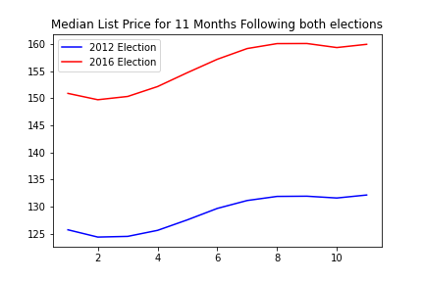
Figure 1: Median Listing Price
P-value = 0.000105

Slide 11
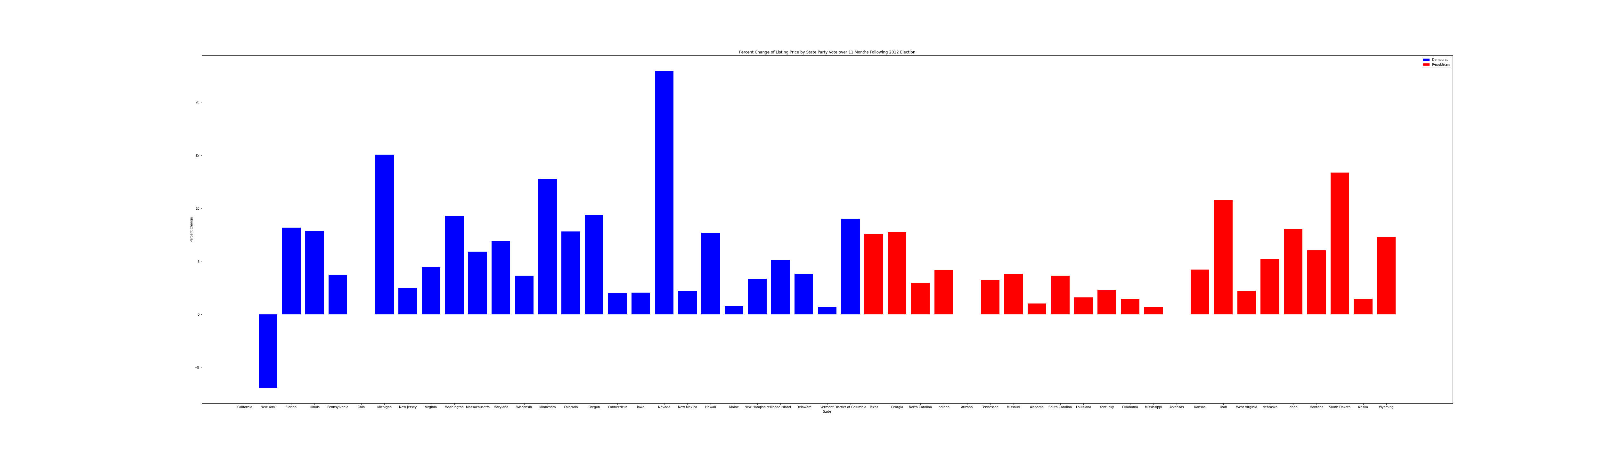
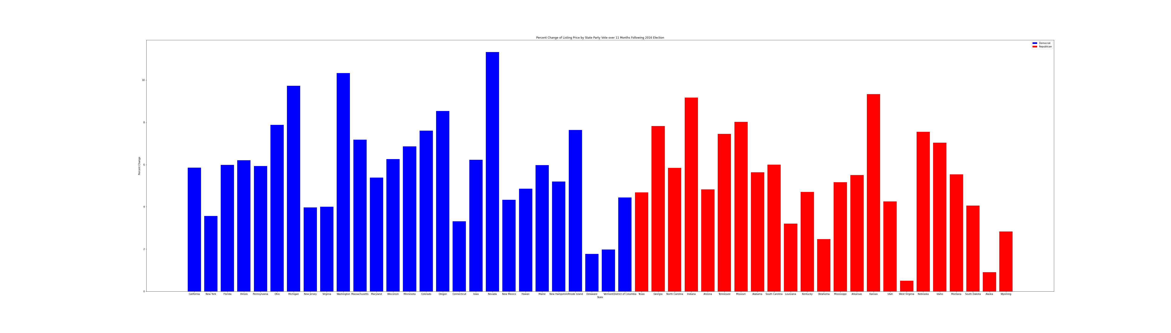
Figures ii & iii: The states, 2012 vs. 2016
2012
2016

Slide 12
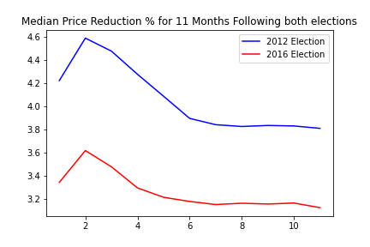
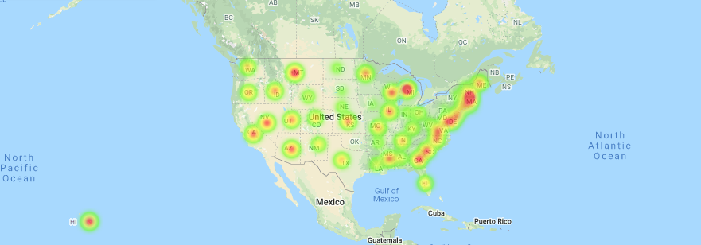
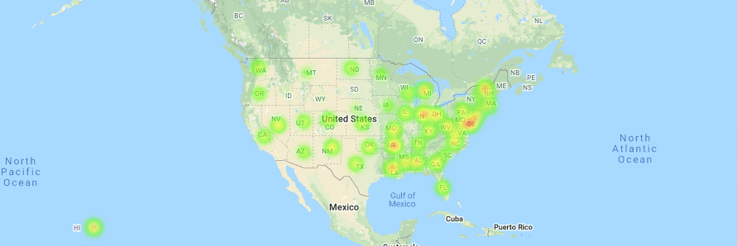
Figure IV: Median Price Reduction
P-value = 1.85 * 10^-6

Slide 13
Discussion
Discuss your findings. Did you find what you expected to find? If not, why not?
We did not expect to find the results for median house listing price that we did, we expected far more volatility in the market due to the nature of both elections and economic circumstances around both elections.
We expected that there would be more inventory for sale after the election in 2012 than there would be after the election in 2016, but not by the margin that there was. Especially when thinking relatively about the number of homes being built across the country annually.
What inferences or general conclusions can you draw from your analysis?
Our conclusion of the results of this data is that the listing price of an individual state is not as contingent on the results of an election, or to a more specific degree, what president the electoral college votes went to as we initially thought could be the case.
Our conclusion to the outcome of this data is that the inventory measure for each state does not follow a discernable trend given the dataset we had to work with. That being said, we believe there is a trend to be found, but more data would be needed.

Slide 14
Post Mortem
Discuss any difficulties that arose, and how you dealt with them
The limitations in this situation were the amounts and type of data that was accessible to us, as well as the lack of granularity our data provided.
One of the limitations we had was when we pulled all the county data for the country. There were 2,289 counties in the data frame which made it difficult to analyze, aided by the fact that most of the county data was incomplete and inconsistent. We dealt with it by focusing on data by state which was mostly complete.
Another limitation was a data limitation, which made it so that we were only able to get 11 months of data after the 2016 election, so for consistency we applied the same ranges to the 2012 election.
During the clean up process of the data frames we encountered NA values and thus utilized formulas that average all valid entries.

Slide 15
Post Mortem
Discuss any additional questions that came up, but which you didn't have time to answer: What would you research next, if you had two more weeks?
We would like to look into other possible impacts on the real estate market surrounding the same time if given more time to do the research, such as economic trends, U.S. involvement in a war, and how state-to-state migration plays a role, if any, in the outcome of this data.
We would like to answer what the raw inventory measure is for more election years, especially factoring in economic circumstances, and new homes built, as well as looking into trends in future elections given the younger generation’s habitation habits (millennials and gen z tend to focus on other things than purchasing a house from a financial perspective than prior generations were).
We would like to deeply explore the market trends that occur within the swing states (North Carolina in particular as it is where we live) to see if market changes coincide with electoral changes.

Slide 16
Questions?

